Slide 1
Vehicle Loan Default Prediction
Team Details
GROUP MEMBERS:
Gokul Mahendran
Krishna Raj P
Nantha Kumar S
Rishi Kumar Raman
Vivekananth
MENTOR:
Mr. Romil Gupta

Slide 2
Introduction
Vehicle loans are the new front in asset quality problems for banks. To be more precise, Financial institutions incur significant losses due to the default of vehicle loans.
This warrants a study to estimate the determinants of vehicle loan default. The problem here is to accurately predict the probability of loanee/borrower defaulting on a vehicle loan in the first EMI (Equated Monthly Instalments) on the due date.
The dataset represents Vehicle Loan Default of L&T financial institution.

Slide 3
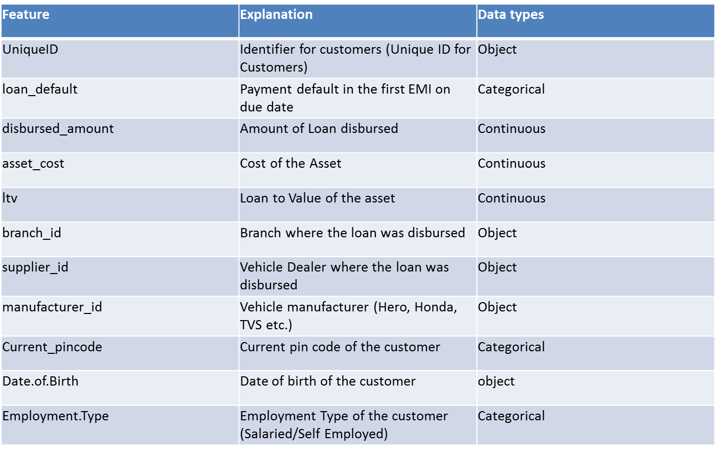
Data Description

Slide 4
Feature | Explanation | Data types
DisbursalDate | Date of disbursement | object
State_ID | State of disbursement | Categorical
Employee_code_ID | Employee of the organization who logged the disbursement | object
MobileNo_Avl_Flag | if Mobile no. was shared by the customer then flagged as 1 | Categorical
Aadhar_flag | if Aadhar was shared by the customer then flagged as 1 | Categorical
PAN_flag | if pan was shared by the customer then flagged as 1 | Categorical
VoterID_flag | if voter was shared by the customer then flagged as 1 | Categorical
Driving_flag | if DL was shared by the customer then flagged as 1 | Categorical
Passport_flag | if passport was shared by then 1 | Categorical
PERFORM_CNS.SCORE | Bureau Score | Categorical
PERFORM_CNS.SCORE.DESCRIPTION | Bureau score description | Categorical
PRI.NO.OF.ACCTS | count of total loans taken by the customer at the time of disbursement | Categorical
PRI.ACTIVE.ACCTS | count of active loans taken by the customer at the time of disbursement | Categorical

Slide 5
Feature | Explanation | Data types
PRI.OVERDUE.ACCTS | count of default accounts at the time of disbursement | Categorical
PRI.CURRENT.BALANCE | total Principal outstanding amount of the active loans at the time of disbursement | Continuous
PRI.SANCTIONED.AMOUNT | total amount that was sanctioned for all the loans at the time of disbursement | Continuous
PRI.DISBURSED.AMOUNT | total amount that was disbursed for all the loans at the time of disbursement | Continuous
SEC.NO.OF.ACCTS | count of total loans taken by the customer at the time of disbursement | Categorical
SEC.ACTIVE.ACCTS | count of active loans taken by the customer at the time of disbursement | Categorical
SEC.OVERDUE.ACCTS | count of default accounts at the time of disbursement | Categorical
SEC.CURRENT.BALANCE | total Principal outstanding amount of the active loans at the time of disbursement | Continuous
SEC.SANCTIONED.AMOUNT | total amount that was sanctioned for all the loans at the time of disbursement | Continuous
SEC.DISBURSED.AMOUNT | total amount that was disbursed for all the loans at the time of disbursement | Continuous
PRIMARY.INSTAL.AMT | EMI Amount of the primary loan | Continuous

Slide 6
Feature | Explanation | Data types
SEC.INSTAL.AMT | EMI Amount of the secondary loan | Continuous
NEW.ACCTS.IN.LAST.SIX.MONTHS | New loans taken by the customer in last 6 months before the disbursement | Categorical
DELINQUENT.ACCTS.IN.LAST.SIX.MONTHS | Loans defaulted in the last 6 months | Categorical
AVERAGE.ACCT.AGE | Average loan tenure | Categorical
CREDIT.HISTORY.LENGTH | Time since first loan | Categorical
NO.OF_INQUIRIES | Enquires done by the customer for loans | Categorical
SEC.INSTAL.AMT | EMI Amount of the secondary loan | Continuous
NEW.ACCTS.IN.LAST.SIX.MONTHS | New loans taken by the customer in last 6 months before the disbursement | Categorical

Slide 7
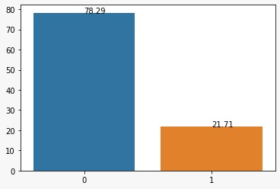
EXPLORATORY DATA ANALYSIS
TARGET VARIABLE
Loan_Default
The count of non defaulters is more than defaulters where 0 (78.29%) is a non defaulter and 1 (21.71%) is a defaulter.

Slide 8
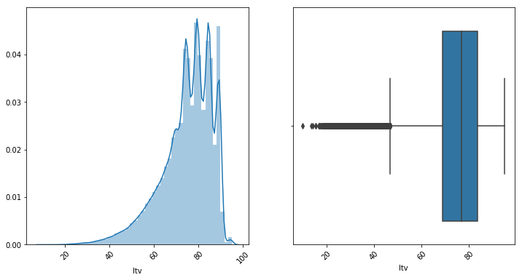
EXPLORATORY DATA ANALYSIS
Numerical Columns
LTV
The loan-to-value (LTV) ratio is a financial term used by lenders to express the ratio of a loan to the value of an asset purchased.
The data seems to be left skewed and we could see outliers in the lower range. Most customers seem to be taking loans for most part of vehicle cost which seems correct as they don’t want most part of their capital into vehicles.

Slide 9
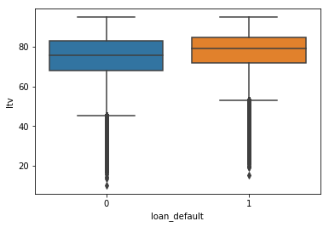
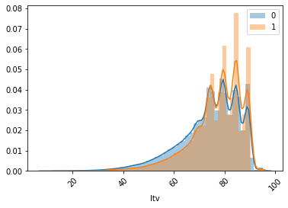
LTV
From the box-plot it is evident that the range of Non defaulters are higher than the range of defaulters for the feature LTV.
From the distribution plot it is clear that as the LTV increases the persons probability of defaulting the loan also increases.
Therefore higher the LTV higher are the chances of a person defaulting the loan.

Slide 10
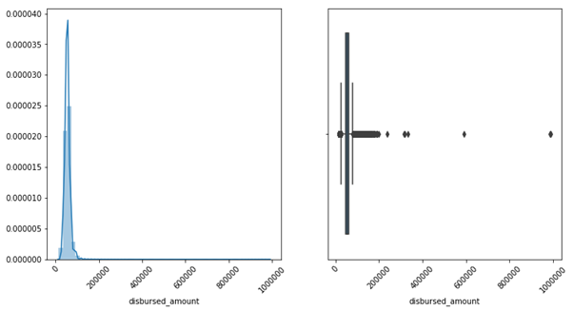
Disbursed Amount
We can see data is right-skewed and outliers are found in the upper range. Extreme Outliers found in the above image are from the non-defaulter’s category.

Slide 11
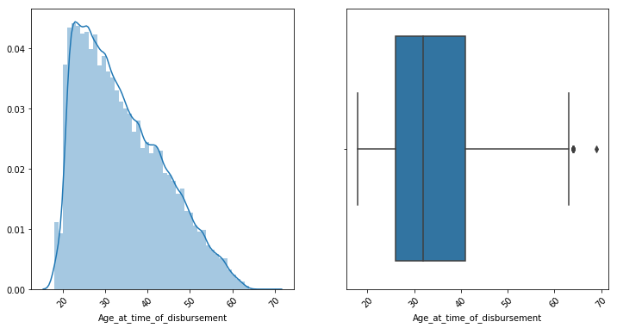
Age at time of disbursement
This is a created feature from Disbursal Date and Date_of_Birth.
This variable seems little close to being a normal distribution with little skewness towards right. We can see a spread from 20 to 70 with peakedness at 20-30.
The majority of people among the age group 28-43.

Slide 12
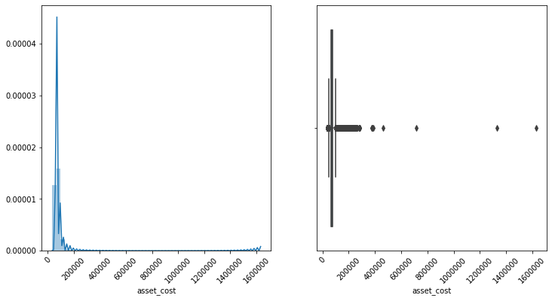
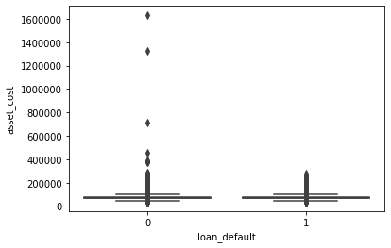
Asset Cost
The data is right skewed and there are outliers present in the upper range.
The outliers are present in the upper range majoritarily among non-defaulter group which is very evident from the boxplot.

Slide 13
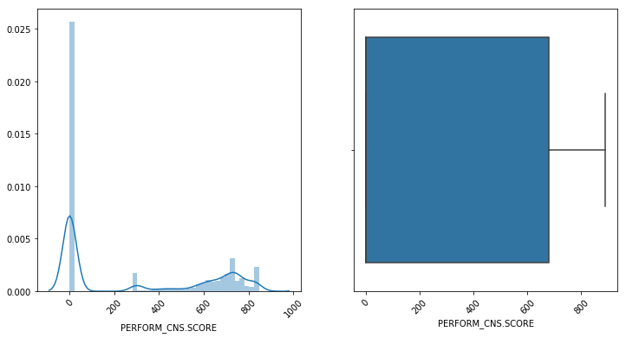
PERFORM CNS SCORE
A CIBIL score is a three-digit number between 300-900, 300 being the lowest, that represents an individual's credit worthiness. A higher CIBIL score suggests good credit history and responsible repayment behavior.
As we lot zeros in the graph which conveys, they are probably first-time loan takers. This score has particular range between 300-900 which portrays the non-existence of outliers.

Slide 14
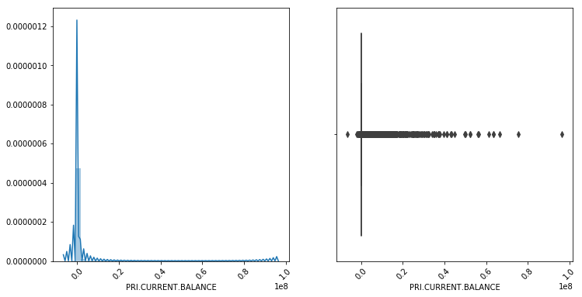
PRIMARY CURRENT BALANCE
When referring to a loan, such as an auto loan or a mortgage, your current balance is the amount you currently still owe on the loan according to the date of your statement.
The data is right skewed and nearly 75% of values seems to zero which shows everyone have paid the previous loan installments. Negative values in the data shows bank owes amount back to borrower.

Slide 15
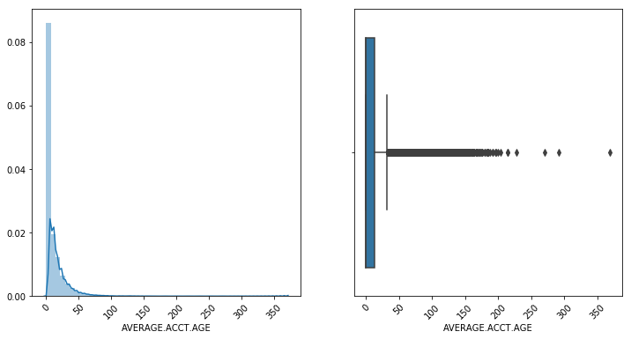
AVERAGE ACCT AGE
AVERAGE.ACCT.AGE gives the information regarding the average duration of loan tenure of the account owned by borrowers.
We could see outliers in upper range and data seems to be right skewed with a lot of zeros.

Slide 16
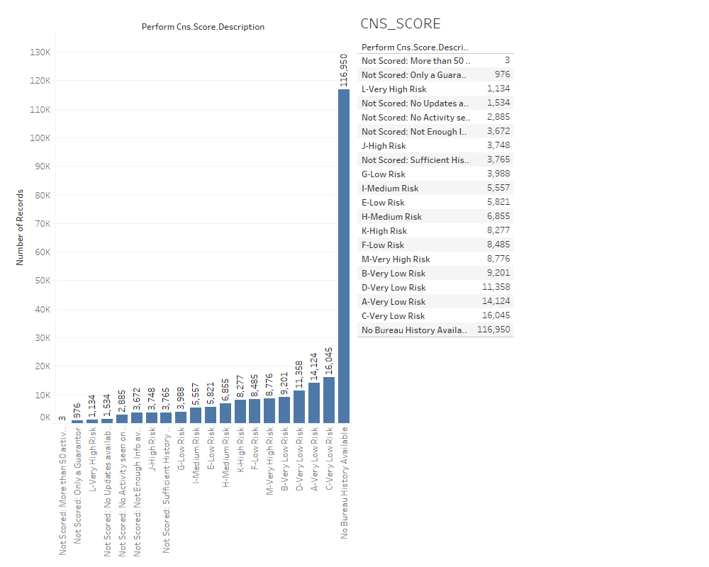
Categorical Columns
PERFORM CNS SCORE DESCRIPTION
Credit scores are based on statistical studies of the relationship between the different items in a credit report and the likelihood of default.
Feature extraction can be performed to the CNS Score Description where in the No scorers can be binned.

Slide 17
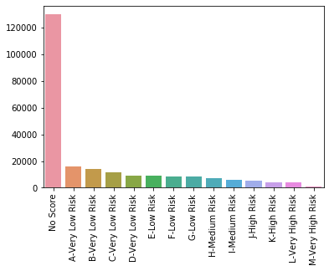
After Feature Extraction
PERFORM CNS SCORE DESCRIPTION
This columns basically represents the Performance CNS score for various ranges.
An important analysis made out from this is there are a greater number of people in Low scoring category.

Slide 18
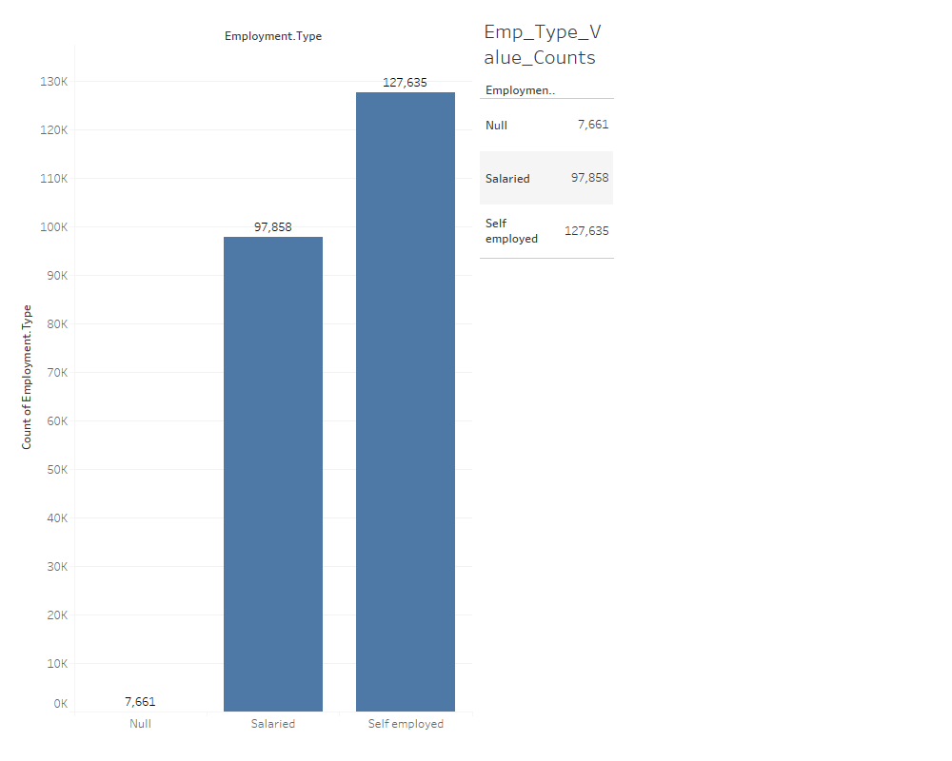
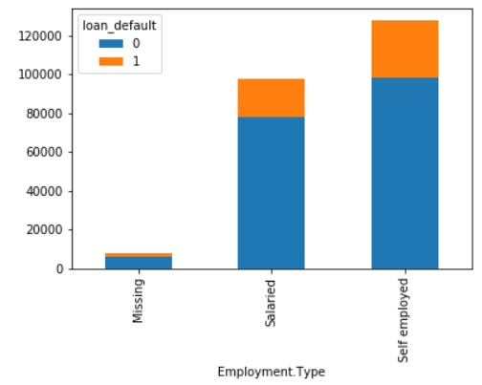
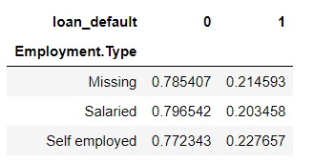
Employment Type
The nulls present in the employee column accounted to 3.29% of the data which was filled with ‘Un-employed’.
After imputations the data resembles the below structure.

Slide 19
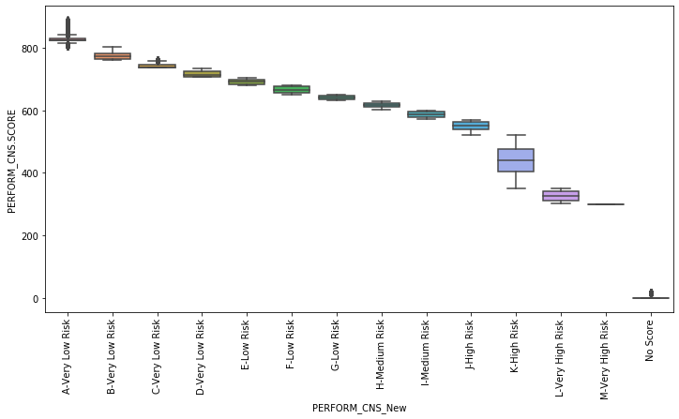
Bivariate analysis and Multivariate analysis
There is a trend found between CNS score description and CNS score.
The data have been binned with respect to CNS score which is very evident from the box plot show above.
As the risk increases the score decreases.
The person who has a higher score will tend to be a non defaulter while the person having a low score would be a defaulter.
All the persons taking a first time loan wont be having a score.

Slide 20
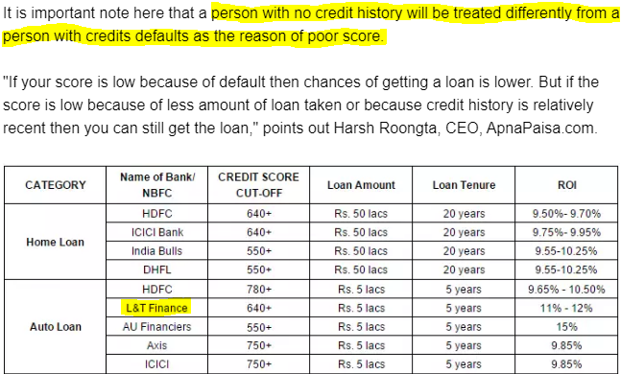
An Aspect to consider with respect to Bivariate analysis
An important aspect in feature engineering is to separate persons who are taking the loan first time since this would directly lead to prediction of person not being a defaulter.

Slide 21
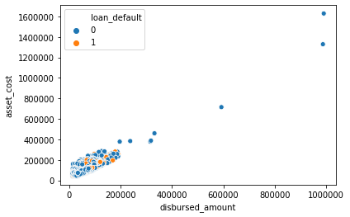
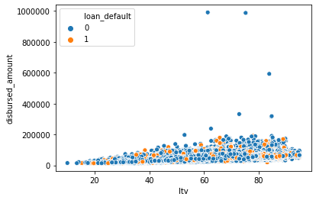
Bivariate analysis and Multivariate analysis
With respect to multivariate analysis disbursed amount seems to be correlated with asset cost and ltv.
Inference
As the disbursed amount increases the asset cost too increases and there are no defaulters as the disbursed amount increases.
With respect to LTV there are no patterns found but there are defaulter as well non defaulters over the entire range. When a person is having a high LTV and high disbursed amount he has probability to pay in the first emi which means he would be more disciplined.

Slide 22
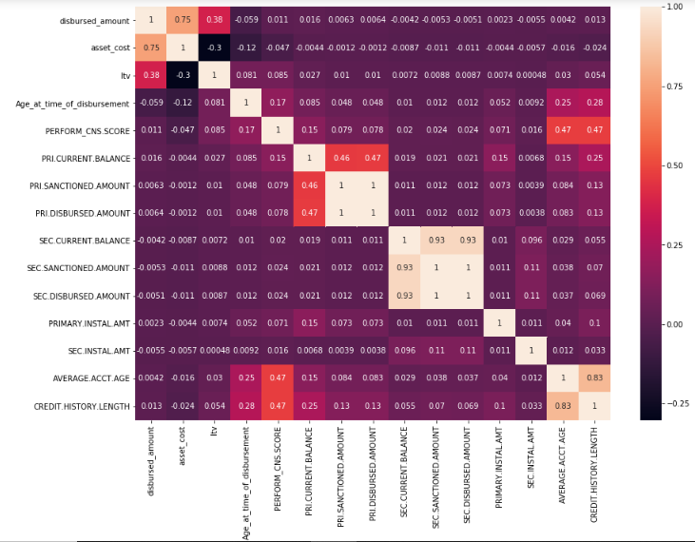
Correlation for Numerical and Categorical Columns

Slide 23
Dashboard for univariate analysis(using Dash & Plotly)
https://capstone-l-t-gokulnumapp.herokuapp.com/

Slide 24
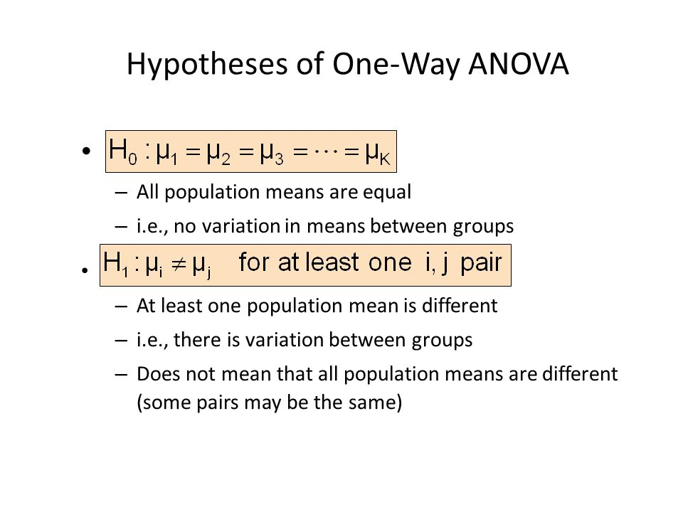

Slide 25
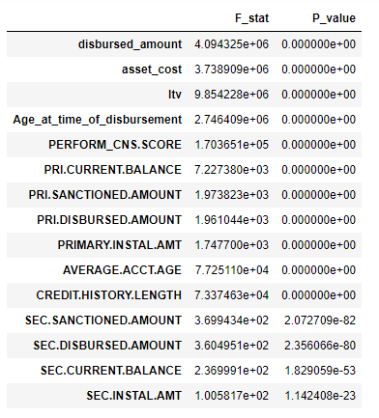
STATISTICAL DATA ANALYSIS
Numerical Columns
OneWay-Anova Test
Since, our target variable is dichotomous and to find whether feature is significant or not, we will do a oneway-anova test to find out the significance of the feature.

Slide 26
Analysis from OneWay-Anova Test
All our variables have rejected the null hypothesis and the hypothesis is in favor of alternate hypothesis which states that the mean of two groups are not equal which will help in splitting our target variable.
These test does explain significance but not strength of the variable associated with the target variable. So, we perform point biserial test to explain the strength.
Why Point Biserial R?
The point biserial correlation coefficient is a special case of Pearson’s correlation coefficient. It measures the relationship between two variables
One continuous variable and binary variable(dichotomous).

Slide 27
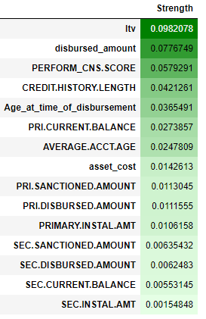
Point Biserial R Test for Numerical Variables
It is clear that ltv, disbursed amount and CNS.SCORE are most important variable, while Secondary loan associated variable seems to be less important.

Slide 28
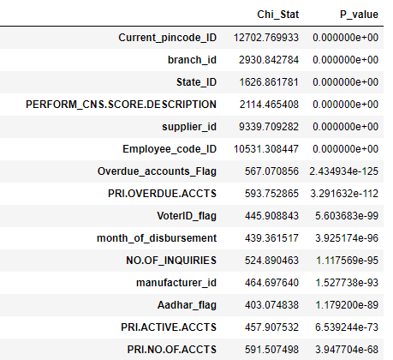
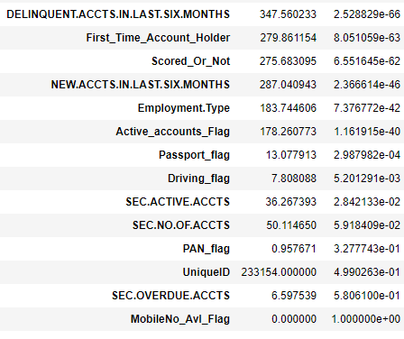
STATISTICAL DATA ANALYSIS
Categorical Columns
Chi-Square Test

Slide 29
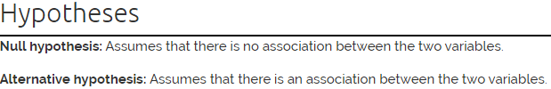
Analysis from Categorical Columns
The Chi-Square test of independence is used to determine if there is a significant relationship between two nominal (categorical) variables.
The frequency of each category for one nominal variable is compared across the categories of the second nominal variable.
From the test, we can see Pan flag, Unique_id, mobileflag and Sec.Overdue.Accts have failed the test and so they are insignificant variables to the target variable.
The strength of categorical variables can be explained with Cramer’s test.

Slide 30
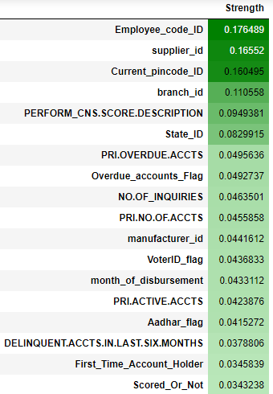
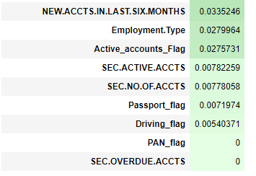
Cramer’s test for Categorical Variables
To find out ,how strongly two categorical variables are associated we do crammers test similar to finding correlation of numerical variables.
Cramer’s V is a number between 0 and 1 that indicates how strongly two categorical variables are associated

Slide 31
Analysis from Cramer’s test for Categorical Variables
We can see that employee_code_id, supplier_id, pincode and branch seems to be strong with target.
But these variables have huge unique values in them. Using them effectively in the model is highly difficult as it can increase no of columns which can cause curse of dimensionality.
Hence, PERFORM.CNS.SCORE.DESC is the most important variable in our case.

Slide 32
Base Model Scores
MODEL | KFOLD BIAS SCORE (AUC)
LOGISTIC REGRESSION | 0.6549
DECISION TREE | 0.5423
RANDOM FOREST CLASSIFIER | 0.663
KNN CLASSIFIER | 0.54

Slide 33
Conclusion
Since tree based perform better, we could tune the models using hyper parameters techniques like Random Search CV, Grid Search CV and stacking of various tree models could give a better AUC score.
As the scope of Feature engineering is low, we can try out frequency encoding of categorical columns and binning of numerical columns.

Slide 34
Thanks!

